Slide 1

A Stochastic Programming Approach In Managing Demand Uncertainty Due to Natural Disaster
Presented by
Imtiajur Rahman

Slide 2
Introduction
In the aftermath of a natural disaster the distribution of pharmaceutical supplies to affected areas becomes a critical challenge.
To address this, we have developed a stochastic programming model for optimizing the distribution network, where mobile pharmacies and hospitals serve as the primary suppliers of essential medications.
The model considers factors such as demand uncertainty and inventory limitations to minimize delivery costs while ensuring that the demand for pharmaceutical supplies is met in disaster-stricken regions.
This simplified yet effective stochastic model and aims to allocate resources efficiently, focusing on both cost reduction.

Slide 3
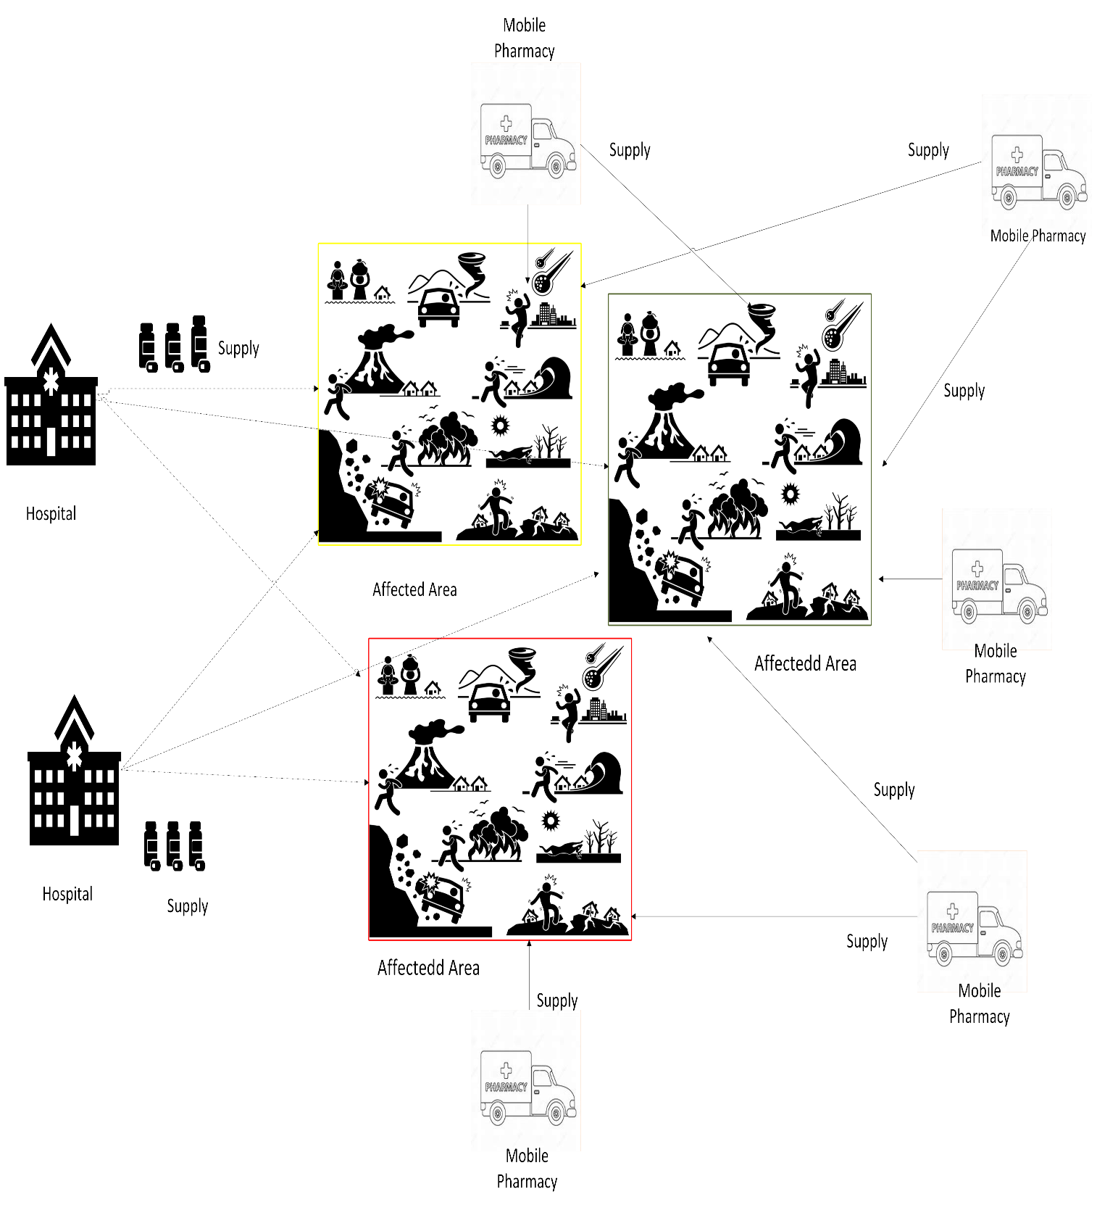

Slide 4
Problem Statement
Objective
Select the best location for facility and optimal quantity to satisfy the demand.
Cost Minimization:
Inventory Cost
Transportation Cost
Movement Cost
Supplier Selection Cost
Facility deployment Cost.
Minimize weighted sum of operational and strategic costs.
min w1*(E[operational costs]) + w2*(strategic costs)
where:
- Operational costs = inventory + transportation + movement costs
- Strategic costs = supplier selection + MP deployment + extra deployment costs
Strategic Decisions: Made before scenario realization (supplier/MP selection)
Operational Decisions: Made after scenario realization (flows, movements)
Two-Stage Stochastic Programming: Accounts for uncertainty in demand
Weighted Objective: Balances immediate operational costs with long-term strategic costs
Mobile Pharmacy Flexibility: Allows relocation in different scenarios

Slide 5
Type of Problem
The model is a two-stage stochastic program with finite number of scenarios and with two objectives in the form of a weighted sum. Thus, the formulation provided is the extensive form (i.e., deterministics equivalent) of the two-stage stochastic model. The solver will use methods appropriate to solve this type of problems such as branch and bround and branch and cut.
Need to determine:
Which Mobile Pharmacy to open?
Which Candidate location to select?
How much amount of the product to be shipped ?

Slide 6
Assumption 1:
We assumed that demand at hospitals and affected areas is known for a limited number of predefined scenarios (e.g., low, medium, high), with fixed probabilities.
Assumption 2:
We allowed extra mobile pharmacies (>3) to be placed or moved after a scenario is realized, with additional cost but no time or logistics delay.
Assumption 3:
We treated all items as fully deliverable and usable without accounting for expiration, compatibility, or storage complexity across locations.

Slide 7

Decision variables
First-Stage (Here-and-now)
Binary variables: $x_{s} = \left\{\begin{aligned}1 if supplier s is selected \\ 0 otherwise\end{aligned}\right\}$ $, ∀ s∈Suppliers$
Binary variables: $x_{m}= \left\{\begin{aligned}1if mobile pharmacy m is deployed in stage 1 \\ 0 otherwise\end{aligned}\right\}$ , m$∈Mobile Pharmacy$
Second-Stage
Binary variables : $α_{mab}^{ω} = \left\{\begin{aligned}1 if Mobile Pharmacy m moves from a to b in scenario ω \\ 0 otherwise\end{aligned}\right\}$
, $∀ω∈Scenarios$,
$∀\text{m} ∈Mobile Pharmacy$,
$∀ a,b ∈candidate location a=!b$
Binary variables :$y_{mb}^{ω}= \left\{\begin{aligned}1if mMobile pPharmacy m is deployed at location b in scenario ω \\ 0 otherwise\end{aligned}\right\}$
, $∀ω∈Scenarios$,
$∀\text{m} ∈Mobile Pharmacy$,
$∀ b ∈candidate location$

Slide 8
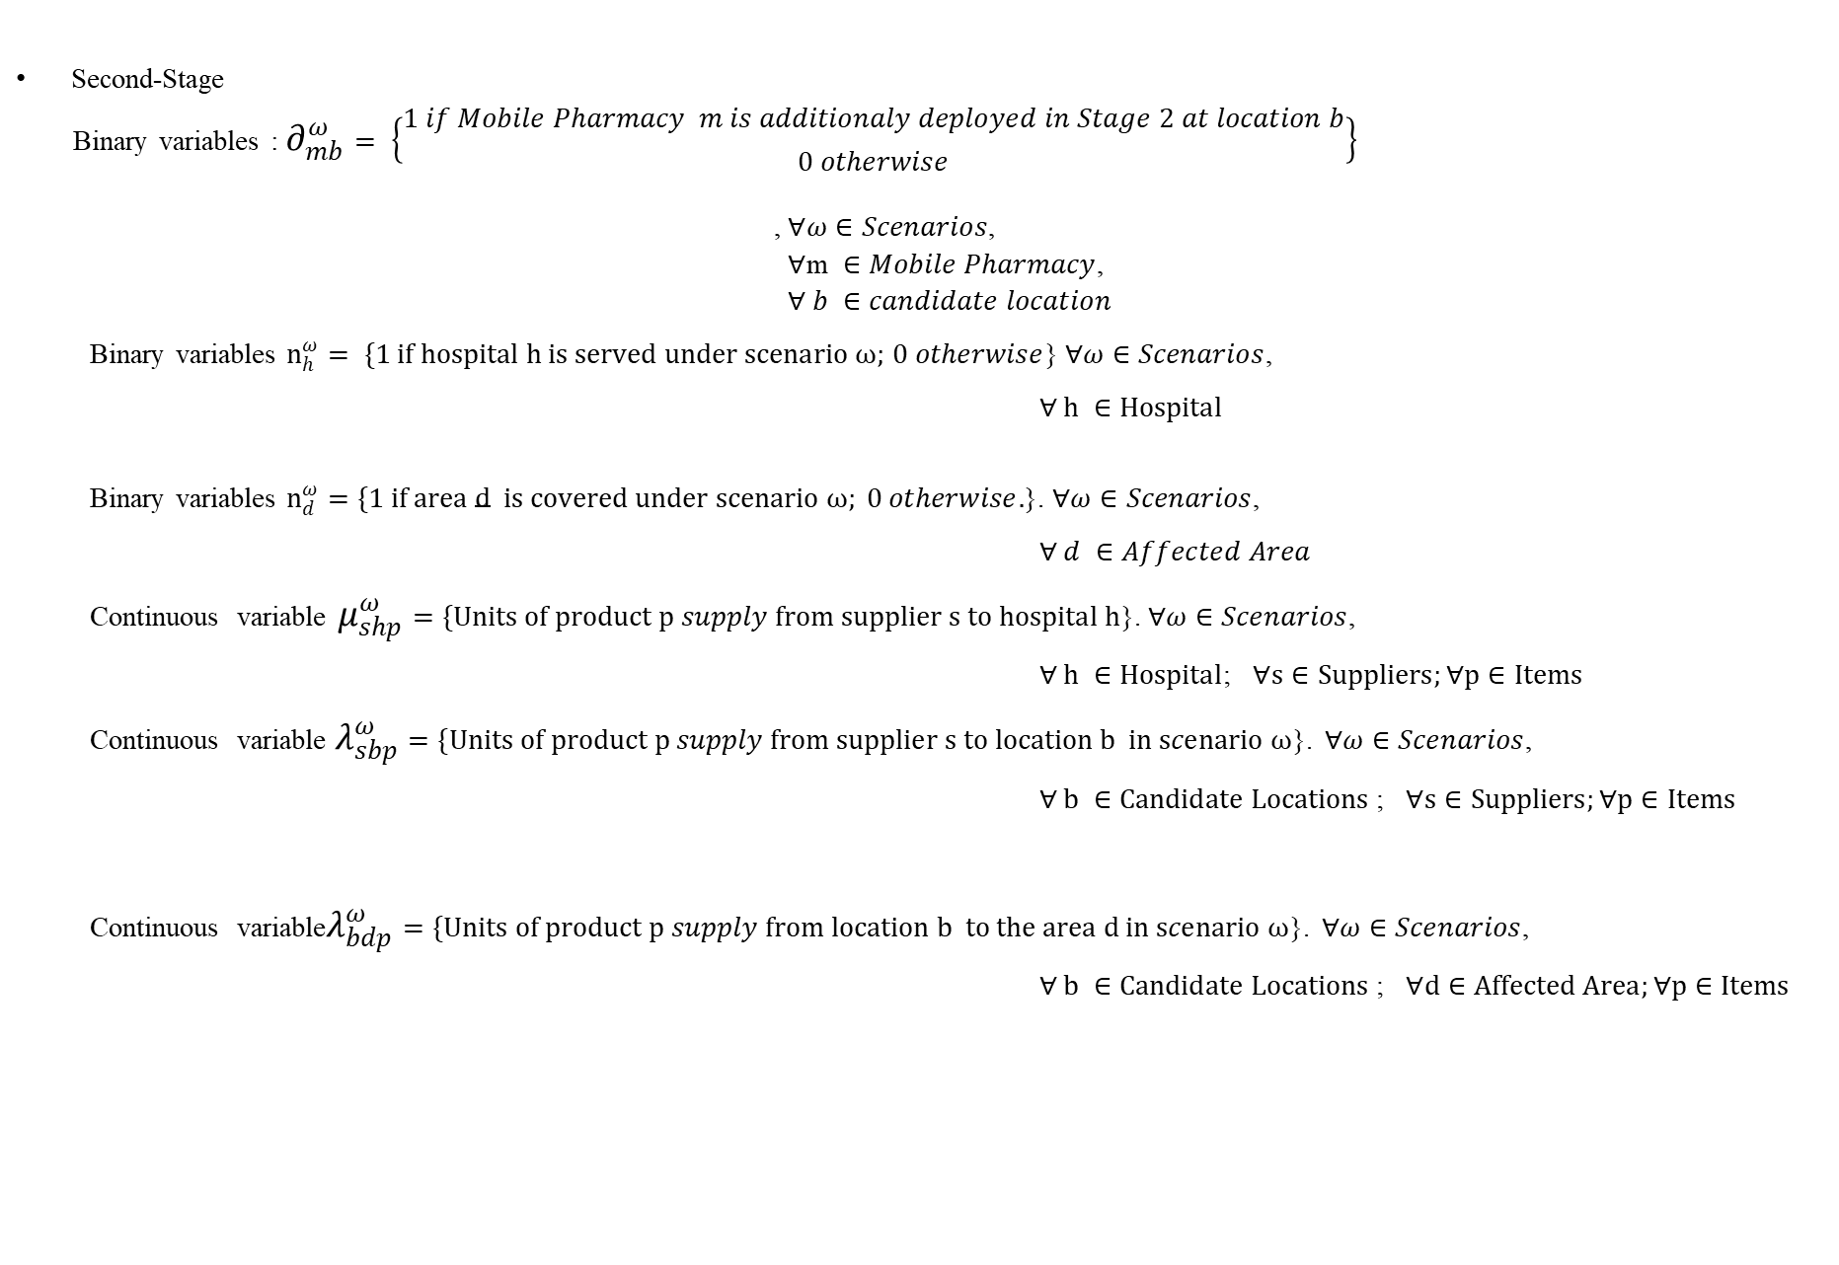
Decision variables
Second-Stage
Binary variables : $∂_{mb}^{ω}= \left\{\begin{aligned}1 if Mobile Pharmacy m is additionaly deployed in Stage 2 at location b \\ 0 otherwise\end{aligned}\right\}$
, $∀ω∈Scenarios$,
$∀\text{m} ∈Mobile Pharmacy$,
$∀ b ∈candidate location$
Binary variables $n_{h}^{ω}= \{1 if hospital h is served under scenario ω;$ $0 otherwise$} $∀ω∈Scenarios$,
$∀ h ∈Hospital$
Binary variables $n_{d}^{ω}=\{1 if area d is covered under scenario ω; 0 otherwise.$}. $∀ω∈Scenarios$,
$∀ d ∈Affected Area$
Continuous variable $μ_{shp}^{ω}=\{Units of product p supply from supplier s to hospital h$}. $∀ω∈Scenarios$,
$∀ h ∈Hospital$; $∀s∈Suppliers;∀p∈Items$
Continuous variable$λ_{sbp}^{ω}=\{Units of product p supply from supplier s to location b in scenario ω$}. $∀ω∈Scenarios$,
$∀ b ∈Candidate Locations$; $∀s∈Suppliers;∀p∈Items$
Continuous variable$λ_{bdp}^{ω}=\{Units of product p supply from location b to the area d in scenario ω$}. $∀ω∈Scenarios$,
$∀ b ∈Candidate Locations$; $∀d∈Affected Area;∀p∈Items$

Slide 9
Set name | Elements
Set of suppliers S | S1', 'S2', 'S3', 'S4’
Set of mobile pharmacies M | 'MP1', 'MP2', 'MP3', 'MP4', 'MP5'
Set of hospitals H | 'H1', 'H2', 'H3'
Set of affected areas D | 'AF1', 'AF2', 'AF3
Set of pharmaceutical products P | 'PI1', 'PI2', 'PI3', 'PI4
Set of demand scenarios | ['low', 'medium', 'high']
Table with list of Indexes

Slide 10
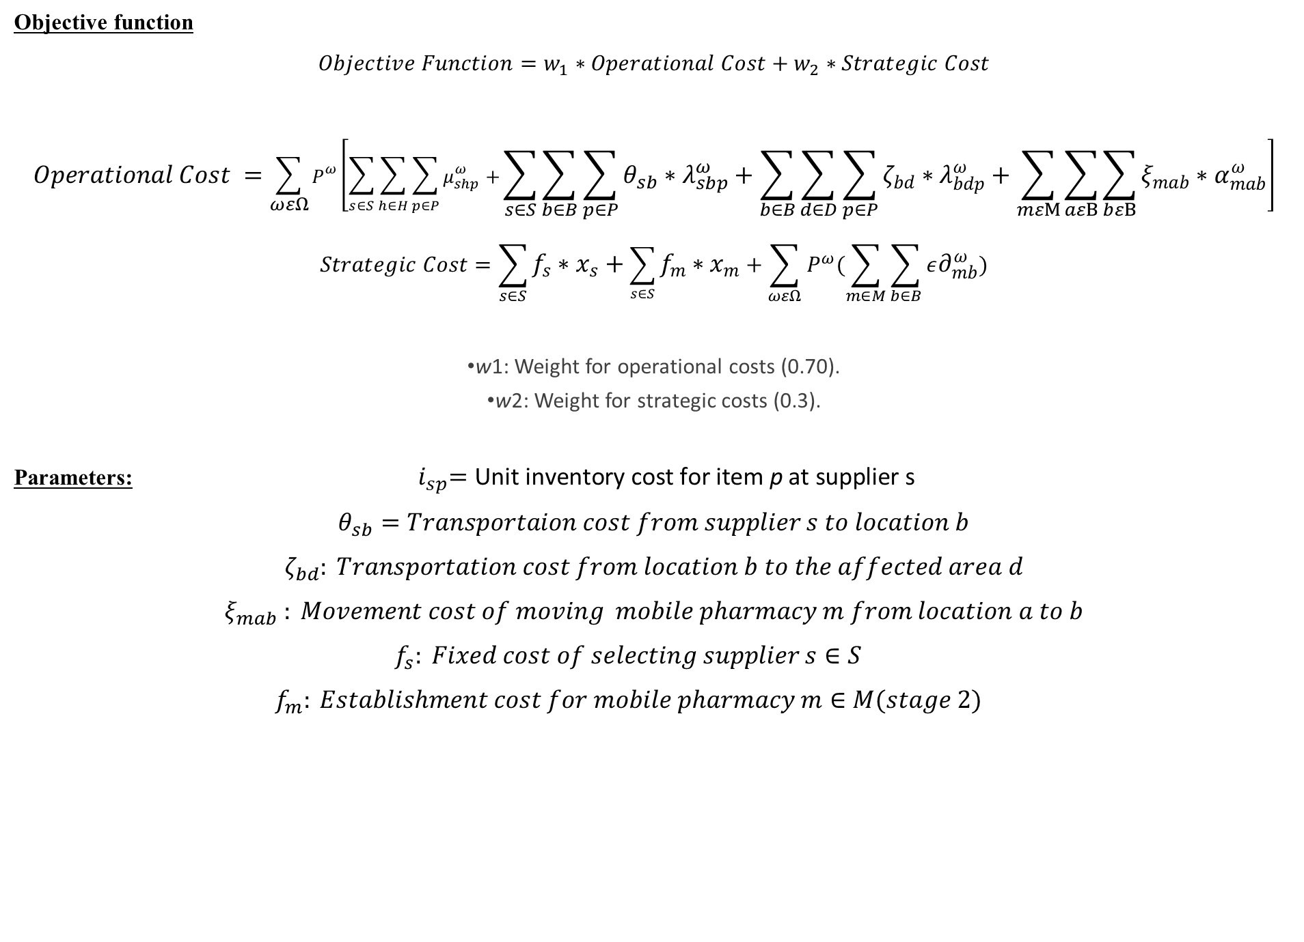
Objective function
$$Objective Function=w_{1}∗Operational Cost+w_{2}∗Strategic Cost$$
$$Operational Cost =\sum_{ωεΩ}{P^{ω}\left[\sum_{s∈S}{\sum_{h∈H}{\sum_{p∈P}{μ_{shp}^{ω}+}}}\sum_{s∈S}{\sum_{b∈B}{\sum_{p∈P}{{θ_{sb}∗λ}_{sbp}^{ω}+\sum_{b∈B}{\sum_{d∈D}{\sum_{p∈P}{ζ_{bd}∗λ_{bdp}^{ω}+\sum_{mεM}{\sum_{aεB}{\sum_{bεB}{ξ_{mab}∗α_{mab}^{ω}}}}}}}}}}\right]}$$
$$Strategic Cost=\sum_{s∈S}{f_{s}∗x_{s}+\sum_{s∈S}{f_{m}∗x_{m}+\sum_{ωεΩ}{P^{ω}(\sum_{m∈M}{\sum_{b∈B}{ε∂_{mb}^{ω}}})}}}$$
w1​: Weight for operational costs (0.70).
w2​: Weight for strategic costs (0.3).
Parameters:${ i}_{sp}=\text{Unit} \text{inventory} \text{cost} \text{for} \text{item} \text{p} \text{at} \text{supplier} \text{s}$
$$θ_{sb}=Transportaion cost from supplier s to location b$$
$$ζ_{bd}​: Transportation cost from location b to the affected area d$$
$$ξ_{mab} ​: Movement cost of moving mobile pharmacy m from location a to b$$
$$f_{s}​: Fixed cost of selecting supplier s∈S$$
$$f_{m}​: Establishment cost for mobile pharmacy m∈M(stage 2)$$

Slide 11

Constraints
Stage 1 Constraints (Before uncertainty is realized)
Supplier Capacity:
$$\sum_{h}{μ_{shp}^{ω}+\sum_{b}{λ_{sbp}^{ω}}}≤ γ_{sp}∗x_{s, }∀s∈S,p∈P, ωεΩ$$
Mobile pharmacy deployment limit (Only 3 mobile pharmacies can be deployed in the first stage):
$$\sum_{m∈M}{x_{m}}=3$$

Slide 12

Constraints
Stage 2 Constraints
Hospital Demand Fulfillment:
$$\sum_{s}{μ_{shp}^{ω}}≤d_{hospital}^{ω} ∀h∈H,p∈P, ωεΩ$$
Affected Area Coverage:
$$\sum_{b}{λ_{bdp}^{ω}≥r∗ d_{affectedarea}^{ω} ∀d∈D,p∈P,ω∈Ω }$$
Mobile Pharmacy Single Location:
$$\sum_{b∈B}{y_{mb}^{ω}≤1, ∀m∈M,ω∈Ω }$$
Stage 2 setup condition for MP
$$y_{mb}^{ω}≤x_{m}+∂_{mb}^{ω}, ∀m∈M,ω∈Ω,b∈B$$

Slide 13

Constraints
Stage 2 Constraints
Flow conservation:
$$\sum_{d∈D}{λ_{bdp}^{ω}≤\sum_{s∈S}{λ_{sbdp}^{ω}}}∀m∈M,ω∈Ω,b∈B$$
MP Storage Capacity:
$$\sum_{d∈D}{λ_{bdp}^{ω}≤\sum_{s∈S}{y_{mb}^{ω}∗}}∈_{m},∀b∈B ,ω∈Ω$$
MP Delivery Limit :
$$\sum_{b∈B}{y_{mb}^{ω}≤1, ∀m∈M,ω∈Ω }$$

Slide 14

Constraints
Stage 2 Constraints
Fixed Hospital/Affected Area Coverage:
$$n_{h}^{ω}=1 , n_{d}^{ω}=1, ∀ h∈H,ω∈Ω ,d∈ D$$
Movement Logic::
$$α_{mab}^{ω}≤y_{maω},$$
$$α_{mab}^{ω}≤y_{mbω}∀m∈M ,a,b∈B,a=!b ,ω∈Ω.$$
${Sign Constraints λ}_{bdp}^{ω}, μ_{shp}^{ω}$, $λ_{sbp}^{ω}≥0$
Number of Decision Variables and Constraints:
Variable types: 984 continuous, 1827 integer (1827 binary)

Slide 15
Cost Breakdown Operational cost (weight 0.7)=$275,204.13 Strategic cost (weight 0.3)=$3,113.40)
Total Cost = $278,317.53
========== STAGE 1 DECISIONS ==========
Suppliers Selected:
- S3
S4
Mobile Pharmacies Deployed in Stage 1:
- MP1 (Deployment cost: $1,800.00)
- MP2 (Deployment cost: $2,000.00)
- MP3 (Deployment cost: $1,800.00)

Slide 16
========== STAGE 2 DECISIONS BY SCENARIO ==========
--- Scenario: LOW (Probability: 20.0%) ---
Mobile Pharmacy Locations:
- MP1 located at CL9 (initially deployed)
- MP2 located at CL8 (initially deployed)
- MP3 located at CL2 (initially deployed)
========== STAGE 2 DECISIONS BY SCENARIO ==========
--- Scenario: MEDIUM (Probability: 50.0%) ---
Mobile Pharmacy Locations:
- MP1 located at CL9 (initially deployed)
- MP2 located at CL8 (initially deployed)
- MP3 located at CL2 (initially deployed)
- MP5 located at CL1 (additionally deployed)
========== STAGE 2 DECISIONS BY SCENARIO ==========
--- Scenario: High (Probability: 30.0%) ---
Mobile Pharmacy Locations:
- MP1 located at CL9 (initially deployed)
- MP2 located at CL8 (initially deployed)
- MP3 located at CL2 (initially deployed)
- MP4 located at CL7 (additionally deployed)
- MP5 located at CL1 (additionally deployed)

Slide 17
Value of Decision Variables (IDE)
Scenario | Probability | Mobile Pharmacy Locations | Supplier to Hospital Flows | Supplier to Mobile Pharmacy Flows | Mobile Pharmacy to Affected Area Flows
LOW | 20.0% | MP1 at CL9, MP2 at CL8, MP3 at CL2 | 80 units each of PI3 and PI4 from S3 to H1, H2, H3; 80 units each of PI1 and PI2 from S4 to H1, H2, H3 | 96 units each of PI4 from S3 to CL2, CL8, CL9; 96 units of PI1, PI2, PI3 from S4 to CL2, CL8, CL9 | 96 units each of PI1, PI2, PI3, PI4 from CL2 to AF1; 96 units each of PI1, PI2, PI3, PI4 from CL8 to AF3; 96 units each of PI1, PI2, PI3, PI4 from CL9 to AF2

Slide 18
Value of Decision Variables (IDE)
MEDIUM | 50.0% | MP1 at CL9, MP2 at CL8, MP3 at CL2, MP5 at CL1 | 100 units each of PI3 from S3 to H1, H2, H3; 100 units each of PI1, PI2, PI4 from S4 to H1, H2, H3 | 80-120 units each of PI1, PI2, PI3, PI4 from S4 to CL1, CL2, CL8, CL9 | 80-120 units each of PI1, PI2, PI3, PI4 from CL1 to AF1; 120 units each of PI1, PI2, PI3 from CL2 to AF1; 120 units each of PI1, PI2, PI3 from CL8 to AF3; 120 units each of PI1, PI2, PI3 from CL9 to AF2
HIGH | 30.0% | MP1 at CL9, MP2 at CL8, MP3 at CL2, MP4 at CL7, MP5 at CL1 | 120 units each of PI3 from S3 to H1, H2, H3; 120 units each of PI1, PI2, PI4 from S4 to H1, H2, H3 | 76-144 units of PI1, PI4 from S3 to CL7, CL1, CL8, CL9; 112-144 units of PI1, PI2, PI3 from S4 to CL2, CL8, CL9 | 108 units of PI1 from CL1 to AF1; 144 units of PI4 from CL1 to AF1; 144 units of PI1, PI2, PI3 from CL2 to AF1; 144 units of PI2, PI3 from CL8 to AF3; 144 units of PI4 from CL9 to AF2

Slide 19
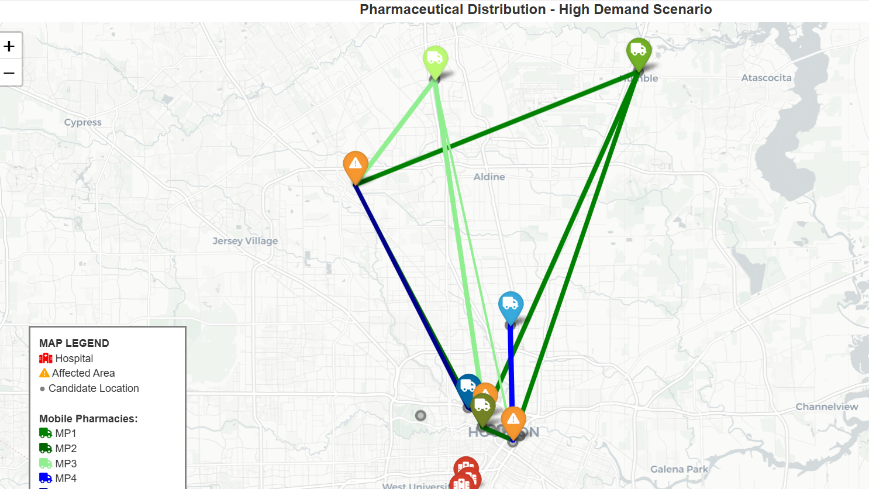

Slide 20
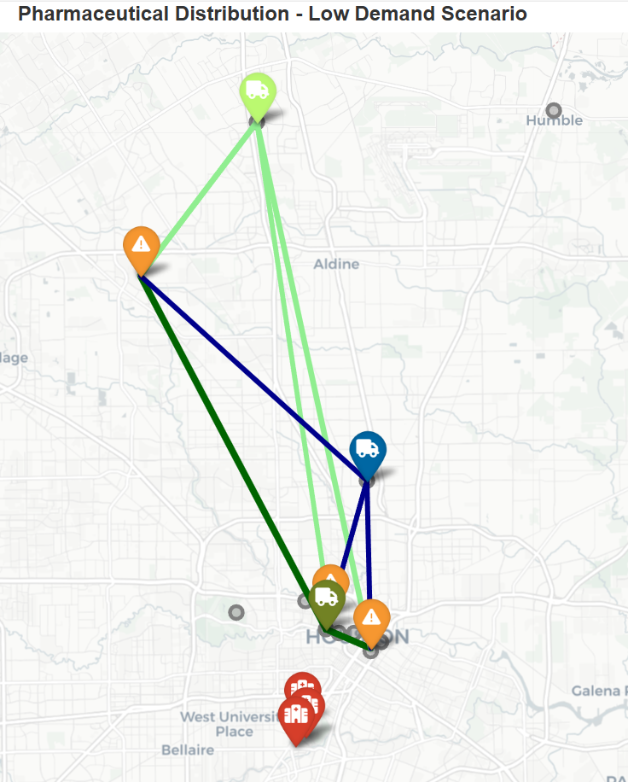
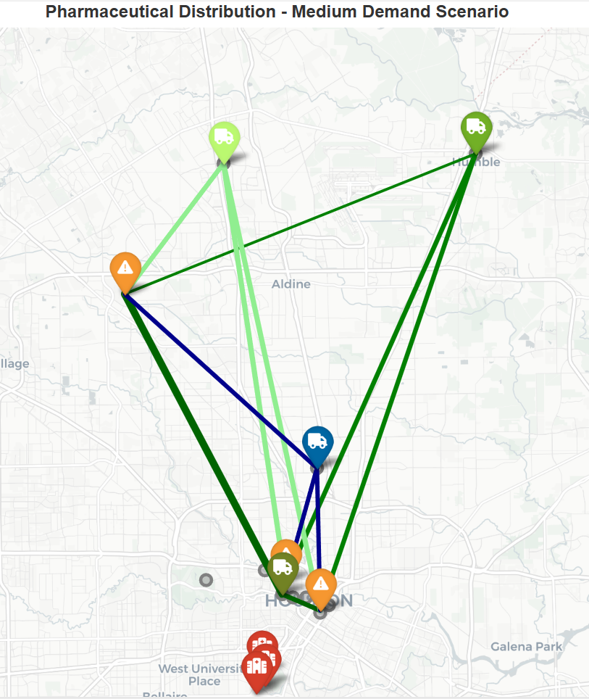

Slide 21
Change-1:
Name of parameter | Total Cost | Effect on MP limit | MP Deployed location in medium Demand | MP Deployed location in High Demand
Change in Demand Low Scenario Hospital-120, Affected Area 150 Medium Scenario Hospital-200, Affected Area 250 High Scenario Hospital-320, Affected Area 380 | $566,561.75 | MP capacity must be increased | MP1 located at CL8 MP3 located at CL2 MP5 located at CL9 | MP1 located at CL2 MP3 located at CL9 MP5 located at CL8
Change in Demand Low Scenario Hospital-220, Affected Area 250 Medium Scenario Hospital-300, Affected Area 350 High Scenario Hospital-420, Affected Area 480 | $812,814.18 | MP capacity must be increased | -MP1 located at CL2 - MP3 located at CL9 - MP5 located at CL8 | - MP1 located at CL2 MP2 located at CL8 MP3 located at CL9 - MP4 located at CL3

Slide 22
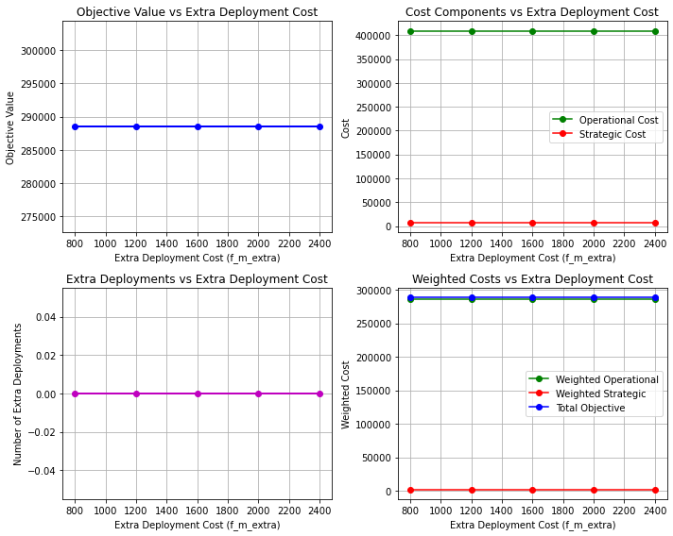
Objective value and different costs Vs The extra deployment cost

Slide 23
Scenario | Testing Probability Distribution | Objective Value | Selected Suppliers | Selected Mobile Pharmacies
LOW | low=0.10, medium=0.56, high=0.34 | $285,713.78 | S3, S4 | MP1, MP3
LOW | low=0.30, medium=0.44, high=0.26 | $270,681.27 | S3, S4 | MP1, MP3
LOW | low=0.50, medium=0.31, high=0.19 | $255,648.75 | S3, S4 | MP1, MP3
LOW | low=0.70, medium=0.19, high=0.11 | $240,616.24 | S3, S4 | MP1, MP3
LOW | low=0.90, medium=0.06, high=0.04 | $225,583.72 | S3, S4 | MP1, MP3
MEDIUM | low=0.36, medium=0.10, high=0.54 | $282,762.40 | S3, S4 | MP1, MP3
MEDIUM | low=0.28, medium=0.30, high=0.42 | $280,479.96 | S3, S4 | MP1, MP3
MEDIUM | low=0.20, medium=0.50, high=0.30 | $278,197.53 | S3, S4 | MP1, MP3
MEDIUM | low=0.12, medium=0.70, high=0.18 | $275,915.09 | S3, S4 | MP1, MP3
MEDIUM | low=0.04, medium=0.90, high=0.06 | $273,632.65 | S3, S4 | MP1, MP3
HIGH | low=0.26, medium=0.64, high=0.10 | $264,026.99 | S3, S4 | MP1, MP3
HIGH | low=0.20, medium=0.50, high=0.30 | $278,197.53 | S3, S4 | MP1, MP3
HIGH | low=0.14, medium=0.36, high=0.50 | $292,368.06 | S3, S4 | MP1, MP3
HIGH | low=0.09, medium=0.21, high=0.70 | $306,538.59 | S3, S4 | MP1, MP3
HIGH | low=0.03, medium=0.07, high=0.90 | $320,709.13 | S3, S4 | MP1, MP3

Slide 24
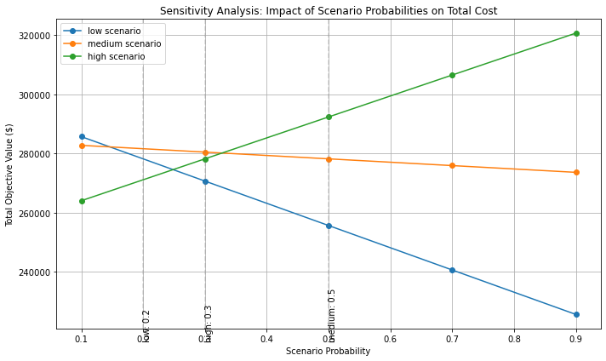

Slide 25
Sensitivity Analysis for Coverage Requirement
Coverage Requirement (r) | Objective Value | Change in Objective
r = 0.60 | $259,307.50 | -6.8%
r = 0.65 | $263,964.47 | -5.1%
r = 0.70 | $268,524.27 | -3.5%
r = 0.75 | $273,264.99 | -1.8%
r = 0.80 | $278,197.53 | 0.0% (Base Case)
r = 0.85 | $282,981.17 | +1.7%
Transport Cost Change | Objective Value | Change in Objective
-30% | $256,426.25 | -7.8%
-20% | $263,683.34 | -5.2%
-10% | $270,940.43 | -2.6%
+0% | $278,197.53 | +0.0%
+10% | $285,454.62 | +2.6%
+20% | $292,711.71 | +5.2%
+30% | $299,968.80 | +7.8%

Slide 26
Conclusion
The analysis conducted in this project focuses on optimizing the pharmaceutical supply chain under different scenarios, incorporating sensitivity analysis to explore the impact of various parameters. The model considers factors such as supplier selection, mobile pharmacy deployment, and coverage requirements in a multi-objective optimization framework.

Slide 27
Thank You

